Slide 1
文章目录
Huang, Yunzhi, et al. "Two-stage CNNs for computerized BI-RADS categorization in breast ultrasound images." Biomedical engineering online 18.1 (2019): 8.
Rodríguez-Cristerna, Arturo, Wilfrido Gómez-Flores, and Wagner Coelho de Albuquerque Pereira. "A computer-aided diagnosis system for breast ultrasound based on weighted BI-RADS classes." Computer methods and programs in biomedicine 153 (2018): 33-40.
Huang, Qinghua, Fan Zhang, and Xuelong Li. "Few-shot decision tree for diagnosis of ultrasound breast tumor using BI-RADS features." Multimedia Tools and Applications 77.22 (2018): 29905-29918.
Chang, Yi-Wei, et al. "A Novel Computer-Aided-Diagnosis System for Breast Ultrasound Images Based on BI-RADS Categories." Applied Sciences 10.5 (2020): 1830.
汇报人： 刘甲莉
Mphil, CUHK(SZ)
2020年5月14日

Slide 2
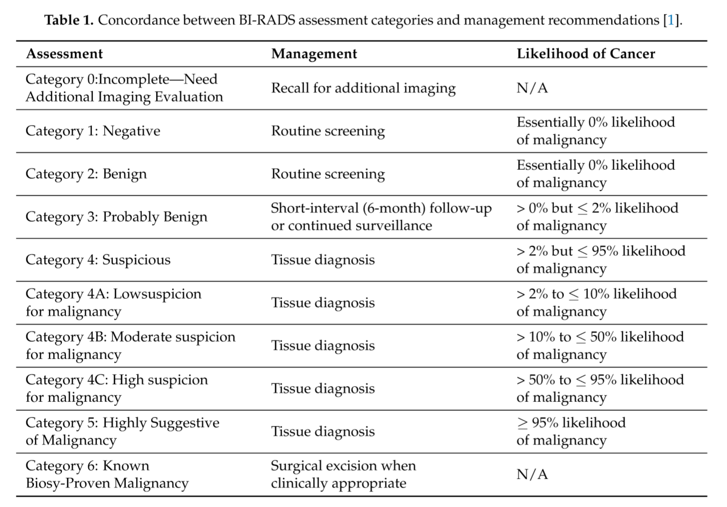
主题简介
BI-RADS是英文 Breast Imaging Reporting and Data System 的简称，是 美国放射协会（ ACR）于1992年建立并推荐的“乳腺影像报告和数据系统”，规范了X线影像报告的术语，2003年又增加了超声和磁共振的内容，便于各个影像学之间进行比较

Slide 3
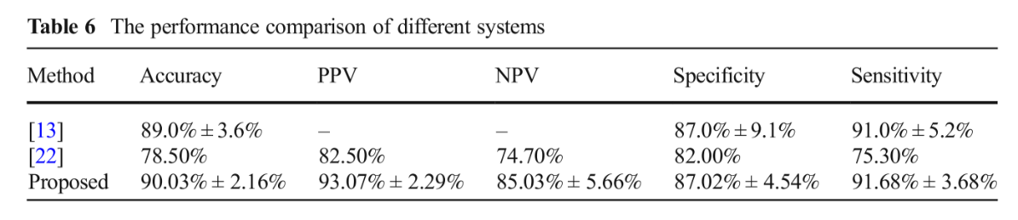
Huang, Qinghua, Fan Zhang, and Xuelong Li. "Few-shot decision tree for diagnosis of ultrasound breast tumor using BI-RADS features." Multimedia Tools and Applications 77.22 (2018): 29905-29918.
IF: 2.101 Q1
Cited by 5, Classification and Segmentation
Dataset：1208=922（ malignant ）+286（ benign ）, BI-RADS

Slide 4
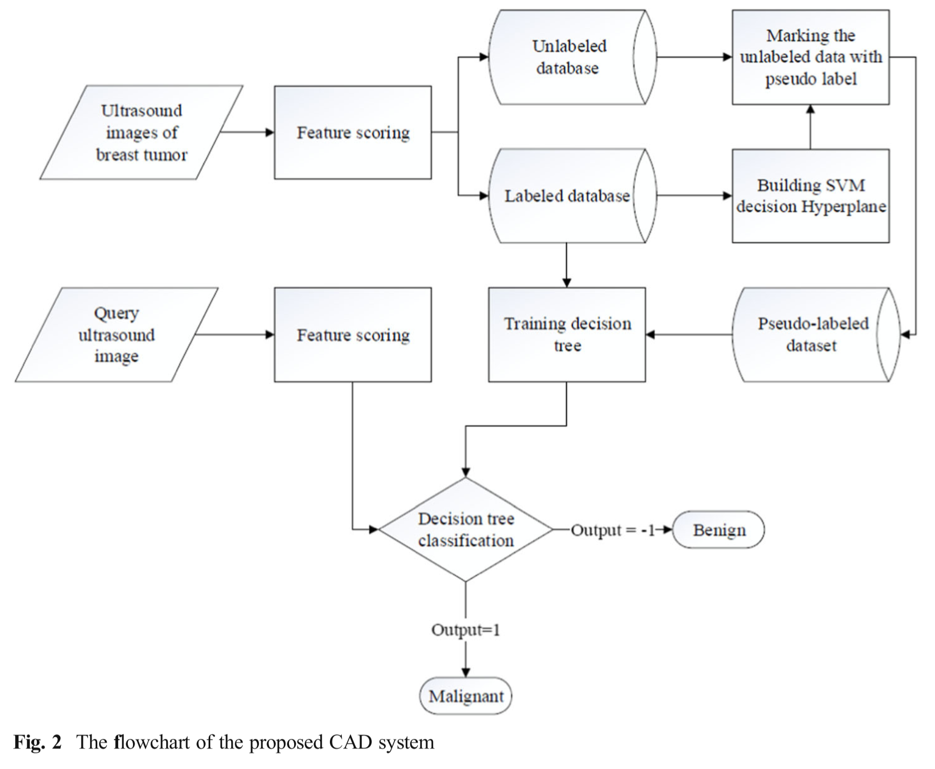
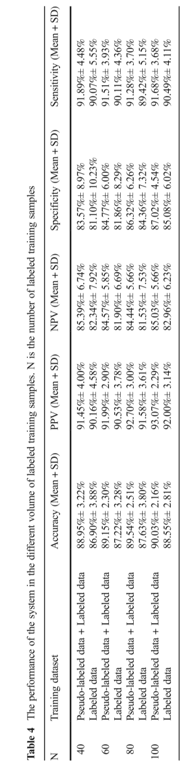
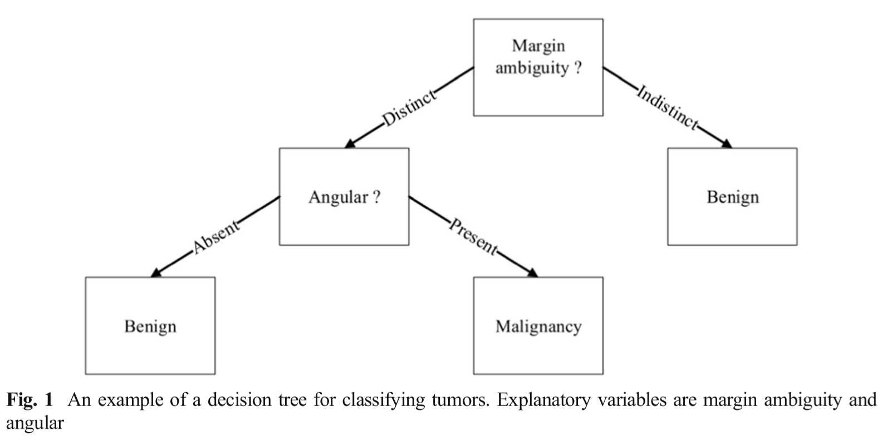
25features ；
a score ranging from 0 to 5
25features ；
a score ranging from 0 to 5；
transformed by clinician

Slide 5
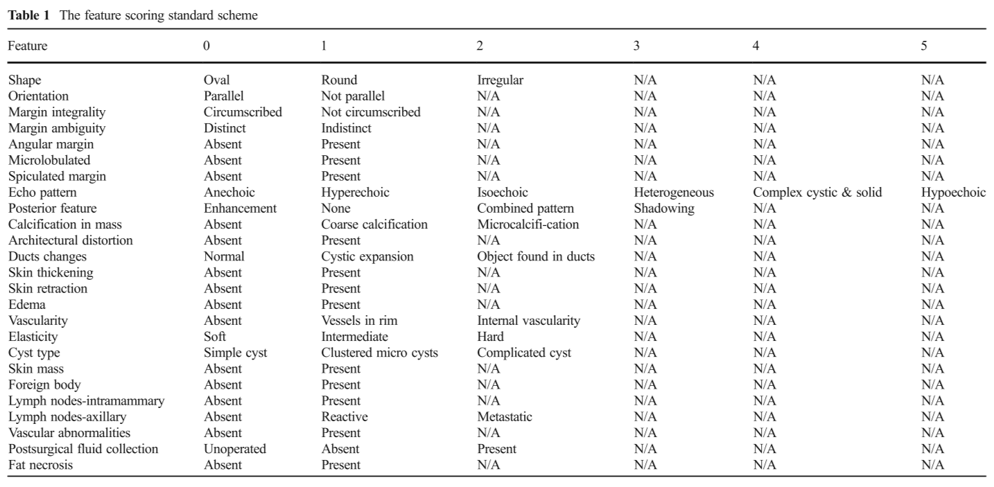

Slide 6
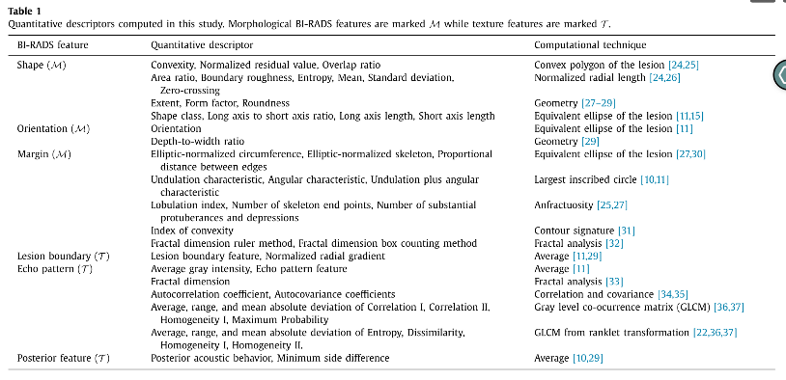
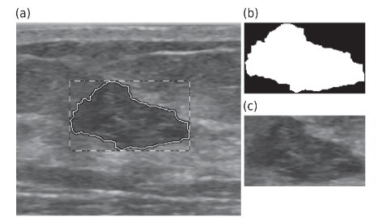
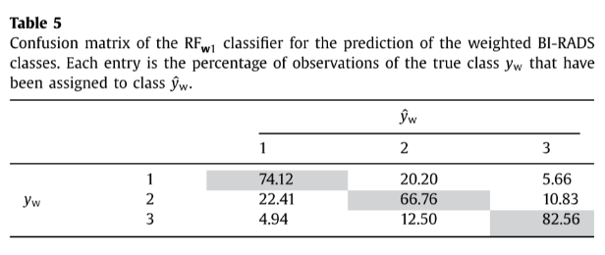
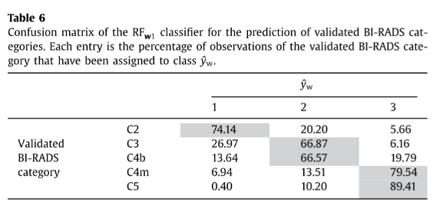
Rodríguez-Cristerna, Arturo, Wilfrido Gómez-Flores, and Wagner Coelho de Albuquerque Pereira. “A computer-aided diagnosis system for breast ultrasound based on weighted BI-RADS classes.” Computer methods and programs in biomedicine 153 (2018): 33-40.
IF: 3.424 Q1
Cited by 11, Classification
Dataset：1128=781（b ）+ 347 （m）, BI-RADS categories
Aiming to cover the BI-RADS features for masses, 37 morphological features，and 179 texture features
Random forest
Supervised learning

Slide 7
The BI-RADS categories were validated by histopathological classes and have the following nomenclatures:
C2, category 2 in benign cases;
C3, category 3 in benign cases;
C4b, category 4 in benign cases;
C4m, category 4 in malignant cases;
C5, category 5 in malignant cases.
？C3m : 数据集不够？
From these validated BI-RADS categories, the dataset was split
into three weighted BI-RADS classes denoted by y w ∈ {1, 2, 3}, where label 1 indicates the benign class (C2),
label 2 denotes the probably benign class (C3 and C4b)
label 3 is reserved for the malignant class (C4m and C5).

Slide 8
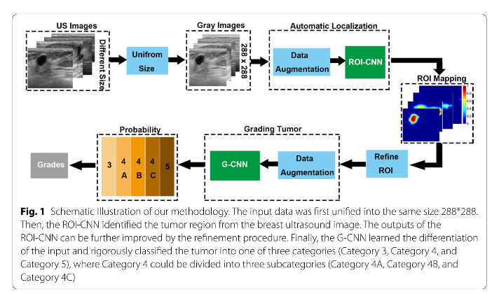
Cited by 3, Classification Dataset：2238 = 531 (3) +443 (4A) + 376 (4B) + 565 (4C) + 323 (5) , BIRADS 分级，分割， 无提及病理，无提及良恶性
Huang, Yunzhi, et al. "Two-stage CNNs for computerized BI-RADS categorization in breast ultrasound images." Biomedical engineering online 18.1 (2019): 8.
IF: 2.013 Q2
random brightness, random contrast, random movement, random flip, and standardization
(1) remove the connected domain with a smaller area (smaller than 40% of the max area) and choose the connected region closest to the image center; and (2) refine the boundary with a typical C–V
level-sets methodology
random movement, in which two augmentations followed by horizontal flipping

Slide 9
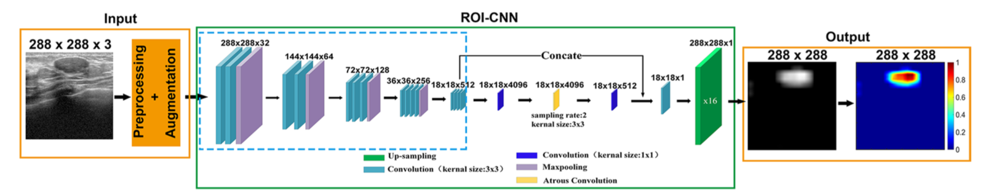
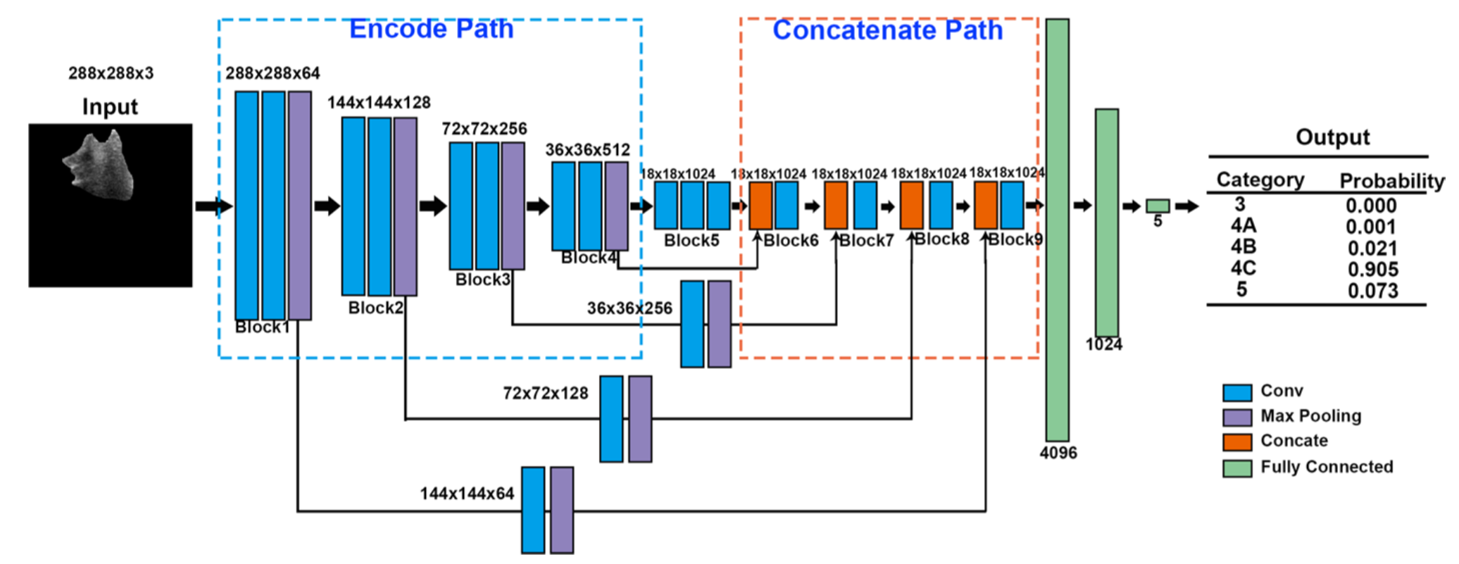
ROI-CNN
G-CNN

Slide 10
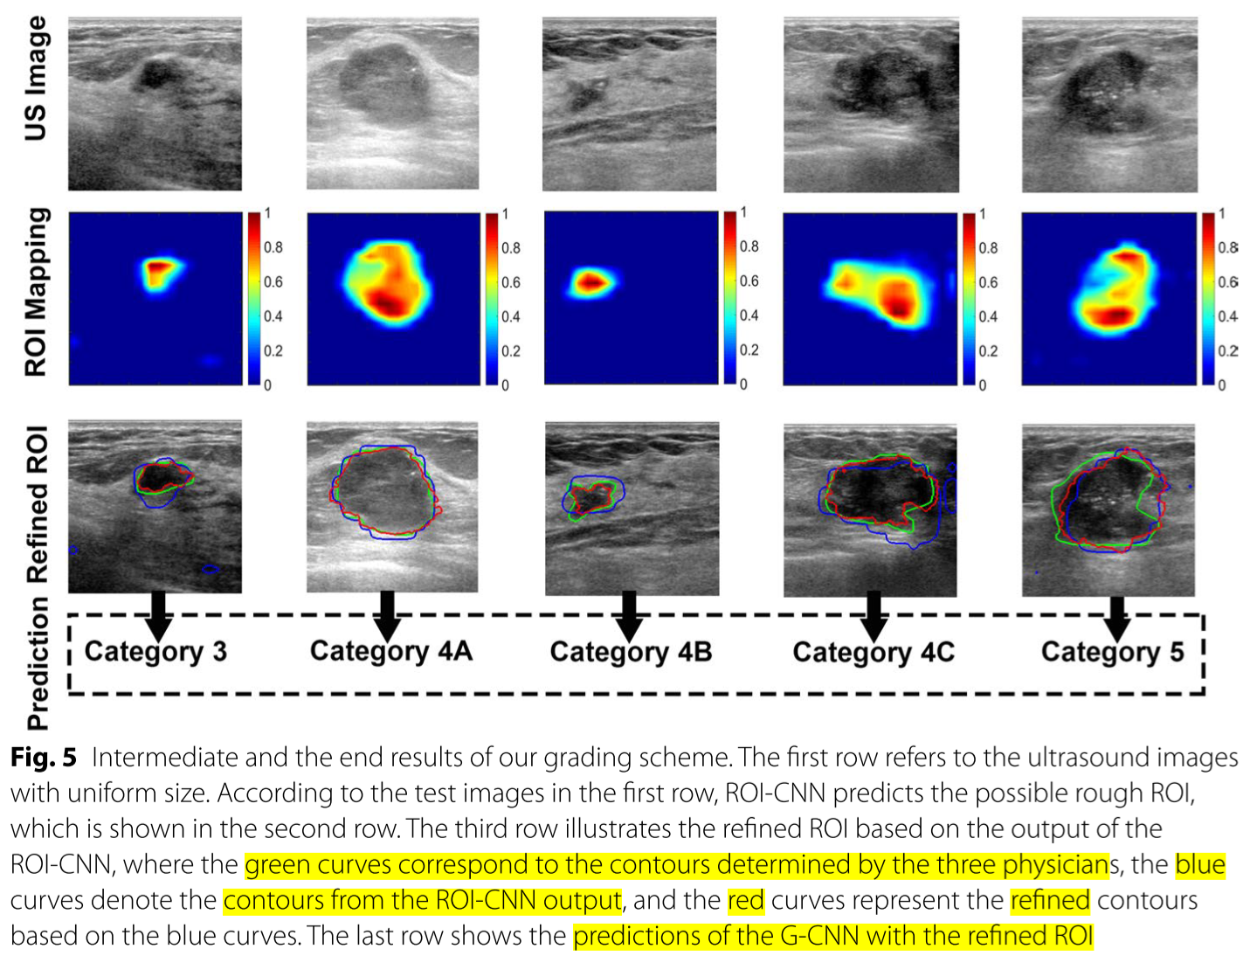
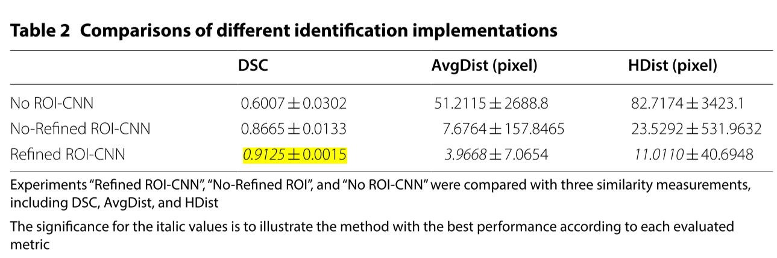
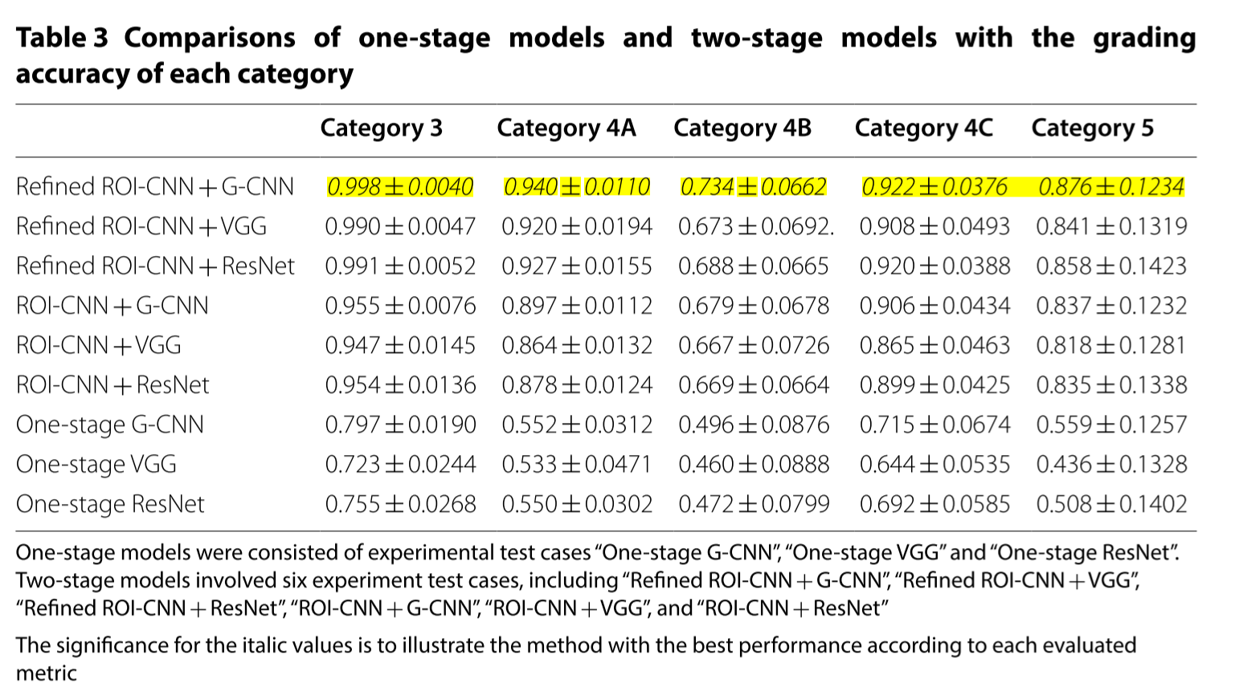
(1) remove the connected domain with a smaller area (smaller than 40% of the max area) and choose the connected region closest to the image center; and (2) refine the boundary with a typical C–V
level-sets methodology

Slide 11
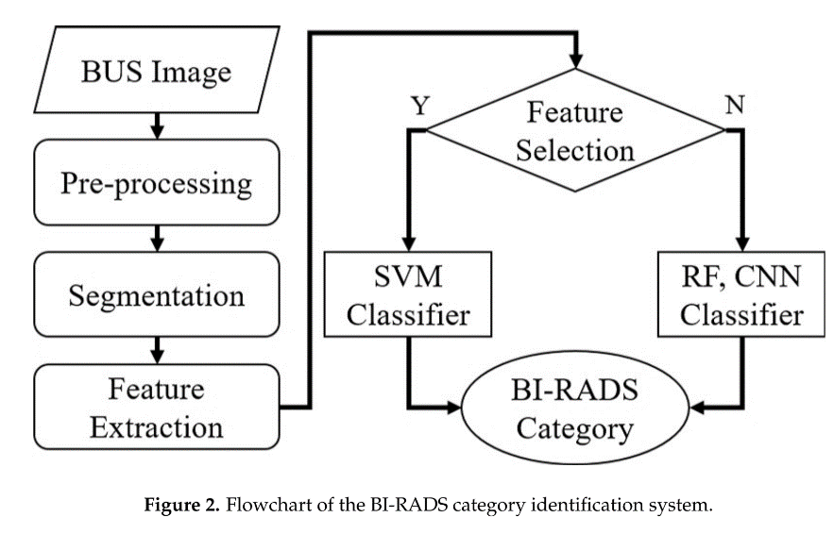
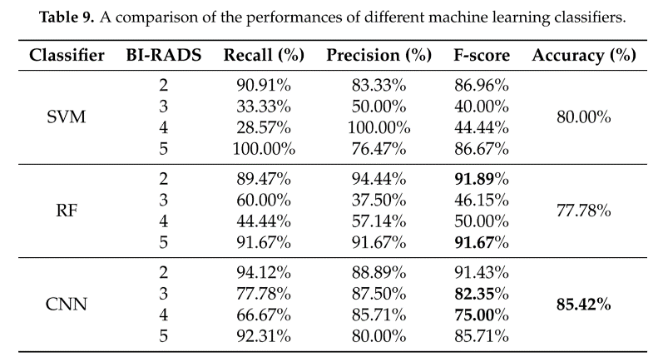
Chang, Yi-Wei, et al. "A Novel Computer-Aided-Diagnosis System for Breast Ultrasound Images Based on BI-RADS Categories." Applied Sciences 10.5 (2020): 1830.
IF: 2.480 Q2
Cited by 0, BIRADS Classification
Dataset : 151=72 (malignant) + 79 (benign), BIRADS

Slide 12
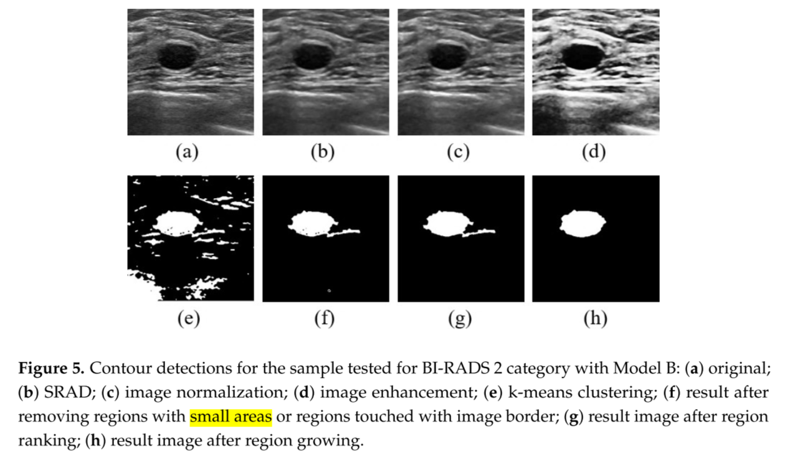
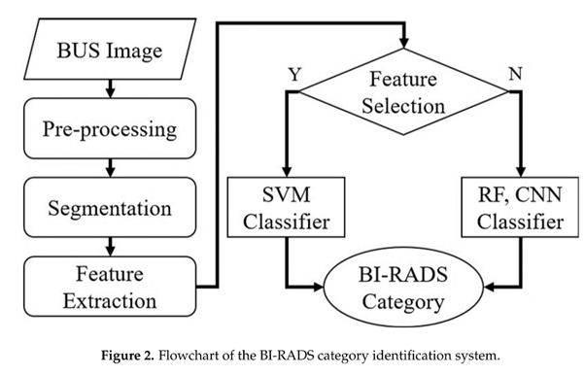
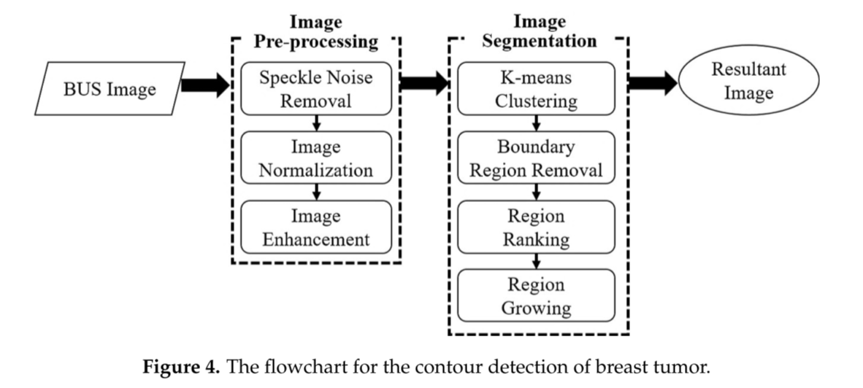
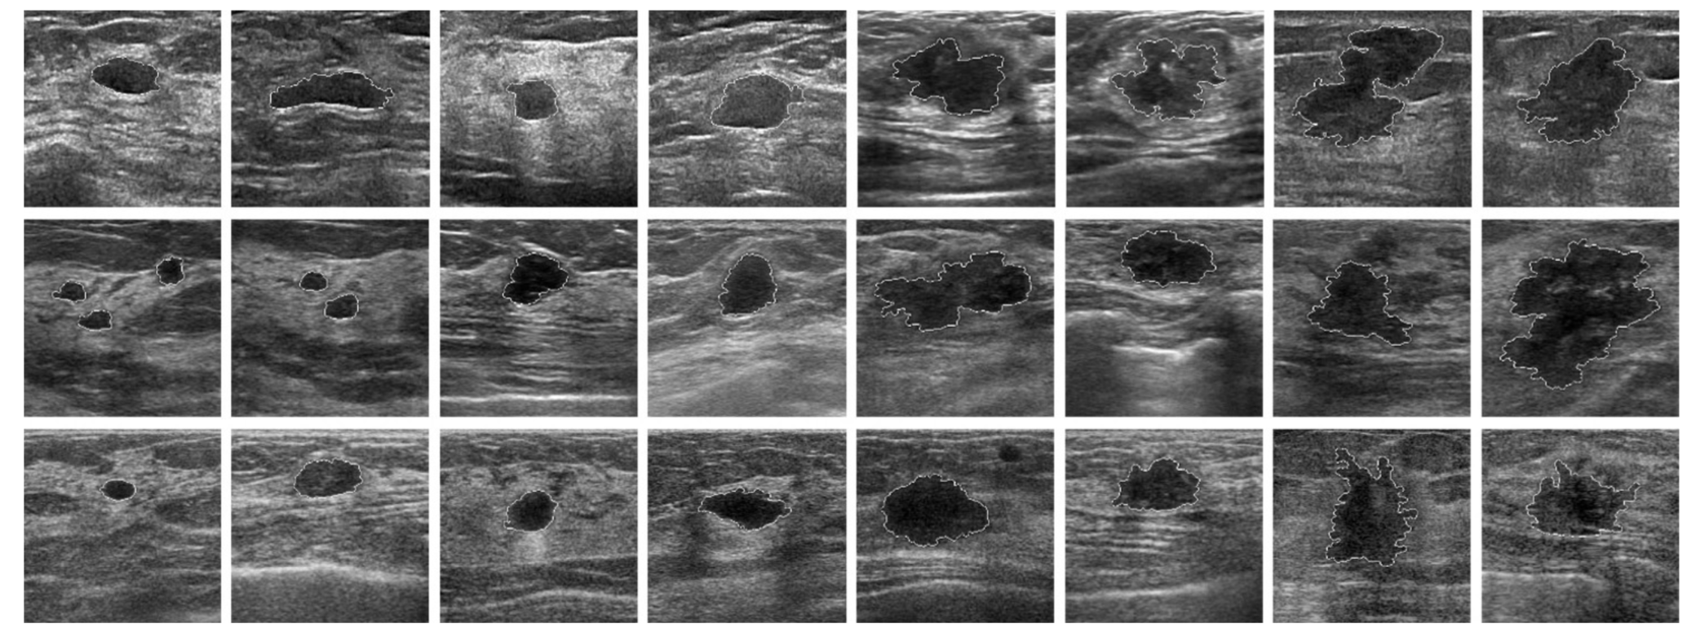

Slide 13
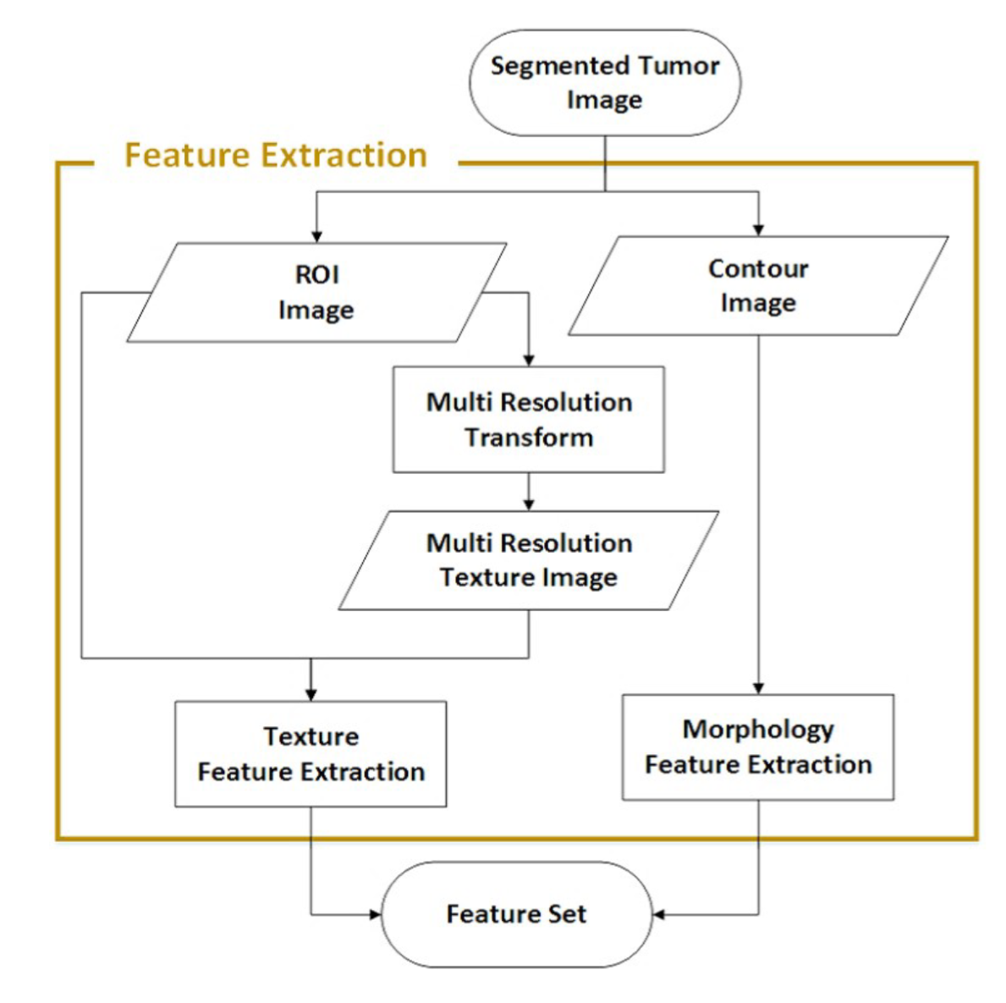
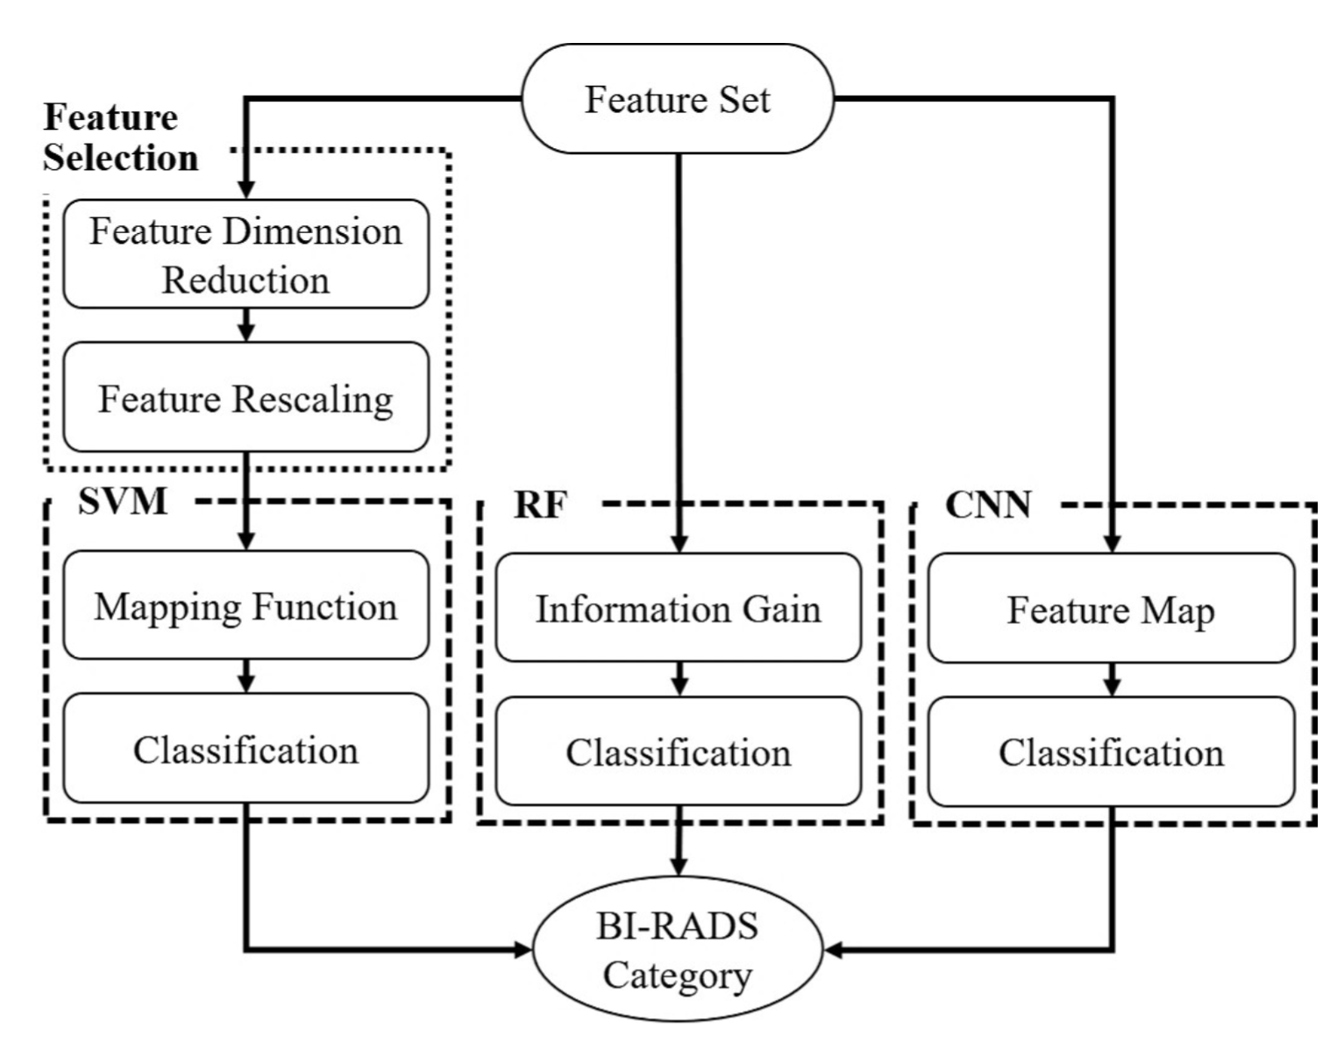
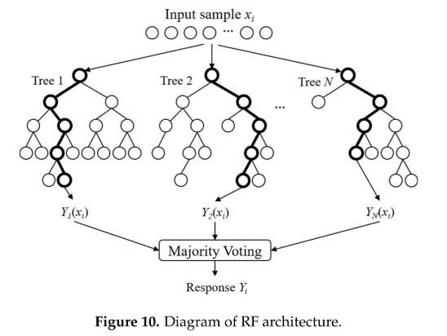
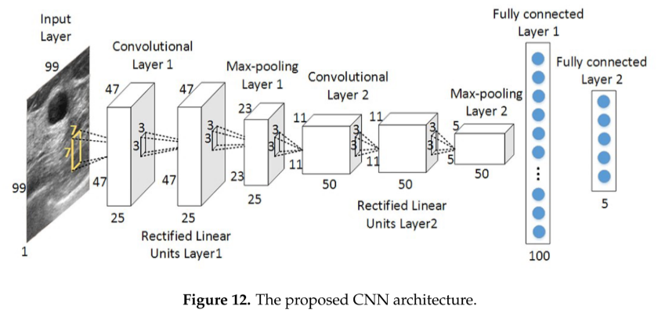
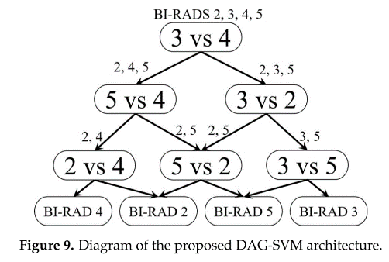
GLCM

Slide 14
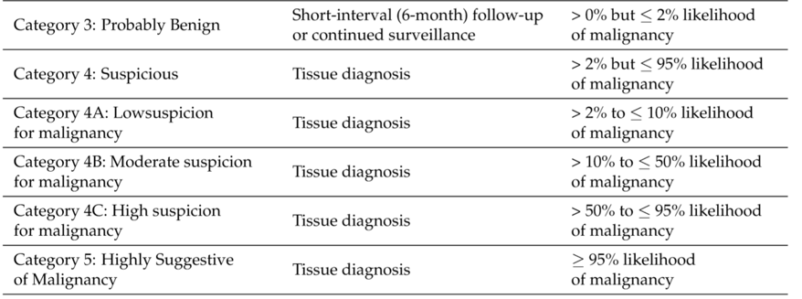
BIRADS 分类方式总结
1.
The BI-RADS categories were validated by histopathological classes and have the following nomenclatures:
C2, category 2 in benign cases;
C3, category 3 in benign cases;
C4b, category 4 in benign cases;
C4m, category 4 in malignant cases;
C5, category 5 in malignant cases.
2.
From these validated BI-RADS categories, the dataset was split
into three weighted BI-RADS classes denoted by y w ∈ {1, 2, 3}, where label 1 indicates the benign class (C2),
label 2 denotes the probably benign class (C3 and C4b)
label 3 is reserved for the malignant class (C4m and C5).
3.
4. Category 2; Category 3; Category 4; Category 5;

Slide 15
感想
做乳腺肿块分类的问题：其分割的信息也有影响
分割出的肿块及肿块周围区域的信息也可能有影响，需要实验验证
BIRADS 信息作为输入信息，还是作为监督信息对肿块的良恶性分类的提升更大，需要更多的讨论

